Slide 1
BookWhiz
RPPOOP Project
112103062 Abhinandan Jugale
112103063 Abhishek Kakade

Slide 2

Introduction
College Academics book recommendations website
First website takes the input form which includes name of the subject, semester and year
According to input field,books will recommend
Photo by Pexels

Slide 3
Need for Project
Lack of Academics books for users
For college student it is easy to study from books
Increasing importance of Academic books
Photo by Pexels

Slide 4

Technologies Used
Flask framework for backend
MySQL database to store books
XAMPP server for database management
HTML, CSS, and some JavaScript for frontend
Bootstrap for responsive design
Photo by Pexels

Slide 5
Project Features
Homepage
Search
Input Form
Result of Book
Add Book
Photo by Pexels

Slide 6

Homepage

Slide 7
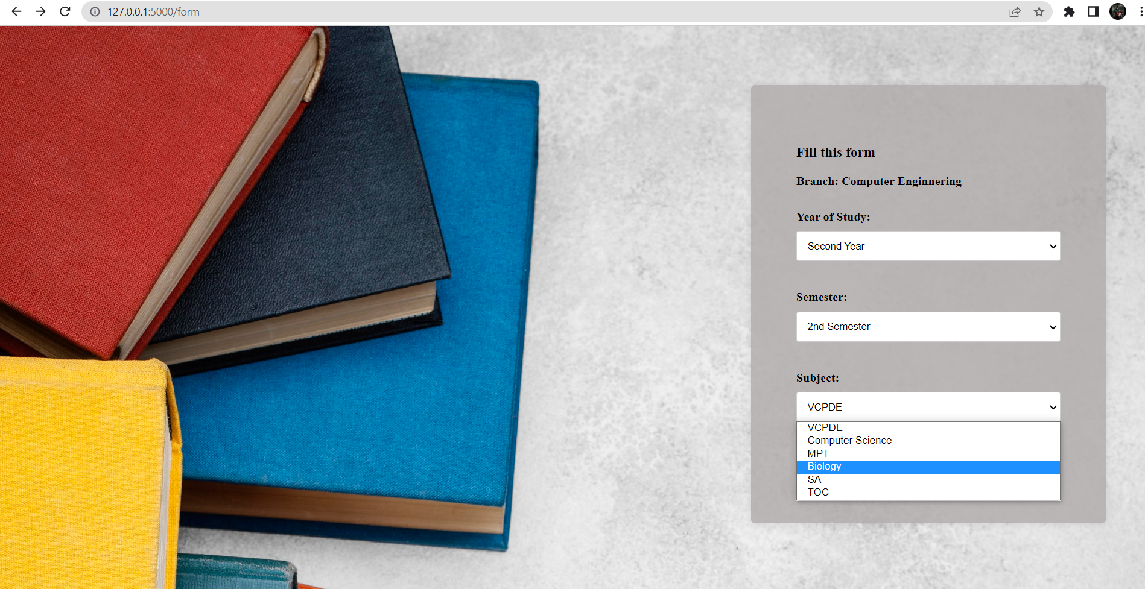
Input Form:

Slide 8
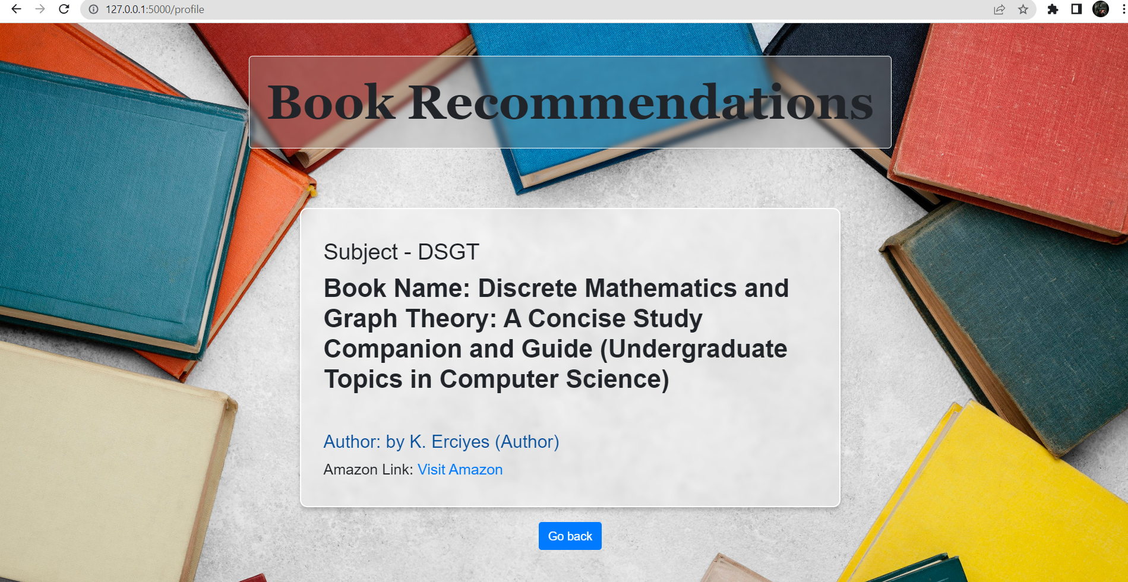
Result Page:

Slide 9
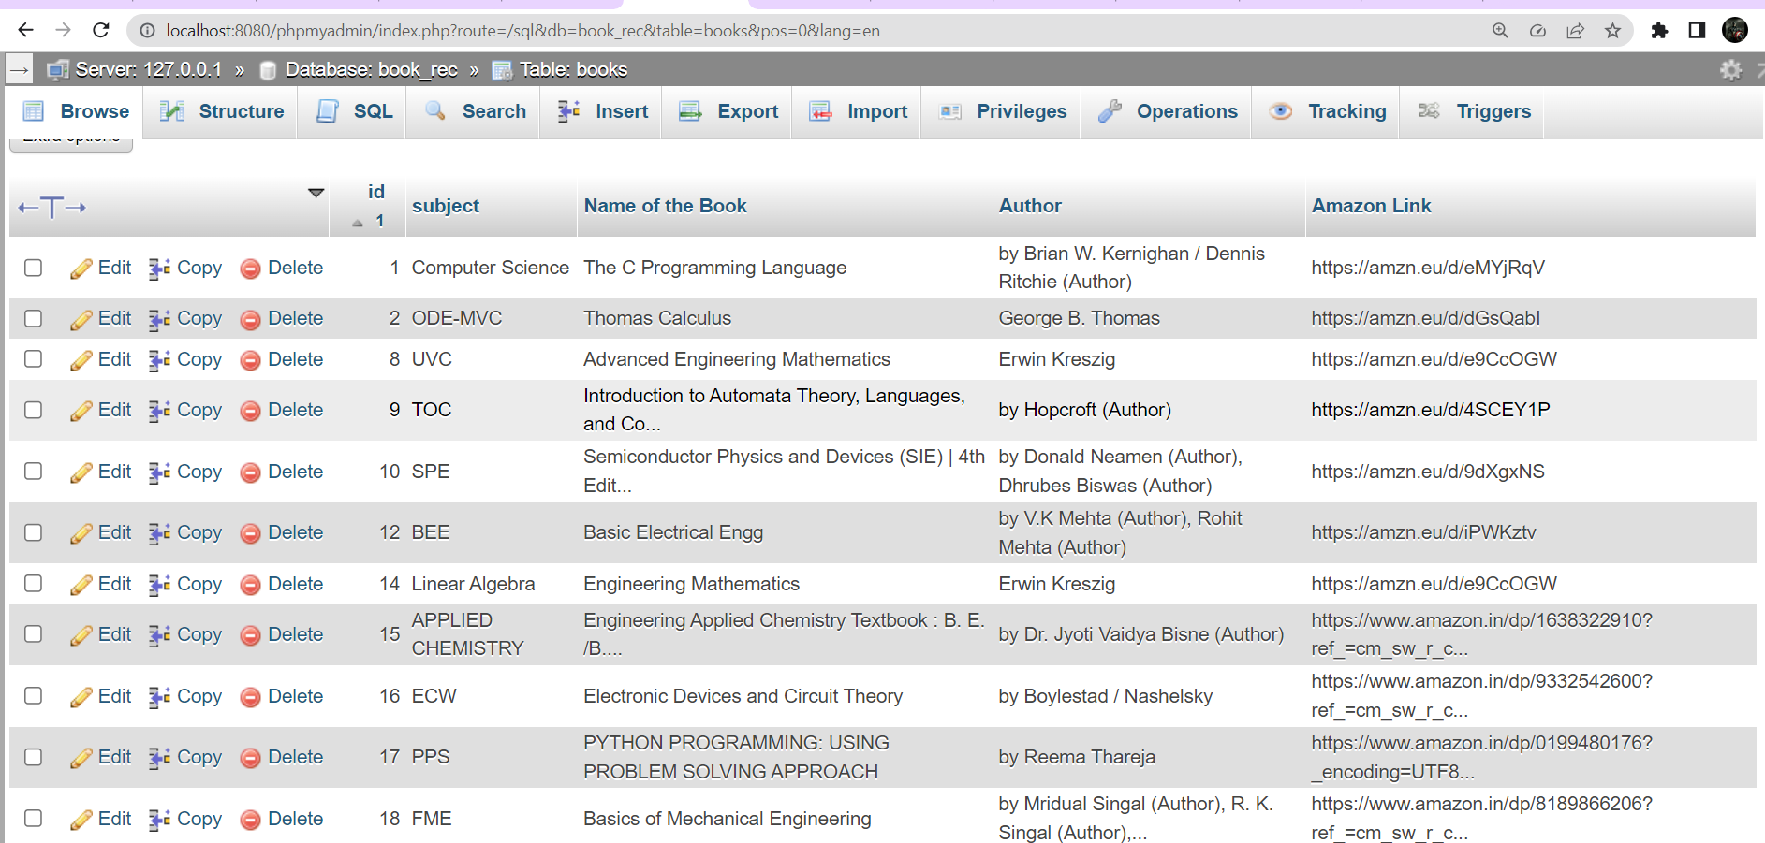
Database Management
Manual input of books into database with phpMyAdmin
Use of SQL queries to retrieve and update data
Adding data from website also
Creation of book object from database query result
Photo by Pexels

Slide 10
Future of Project
Plans to expand database with more books and subjects
Integration with external book APIs
Improvements to search algorithm
Improvements to result page by giving the whole idea of book
Photo by Pexels

Slide 11
Thank You

